Slide 1

Foreign Direct Investment Analytics
By-Mehakpreet kaur

Slide 2
About the Project
This project is about to understand the Foreign direct investment in India for the last 17 years from 2000-01 to 2016-17. The dataset that is provided contains sector and financial year-wise data of FDI in India, Sector-wise investment analysis and Year-wise investment analysis.

Slide 3
For this analysis I use Tableau and generate insights through it .
Details of data
Sector
Investment of different years
2000-01
2001-02
2002-03
2003-04 to ------ 2016-17

Slide 4
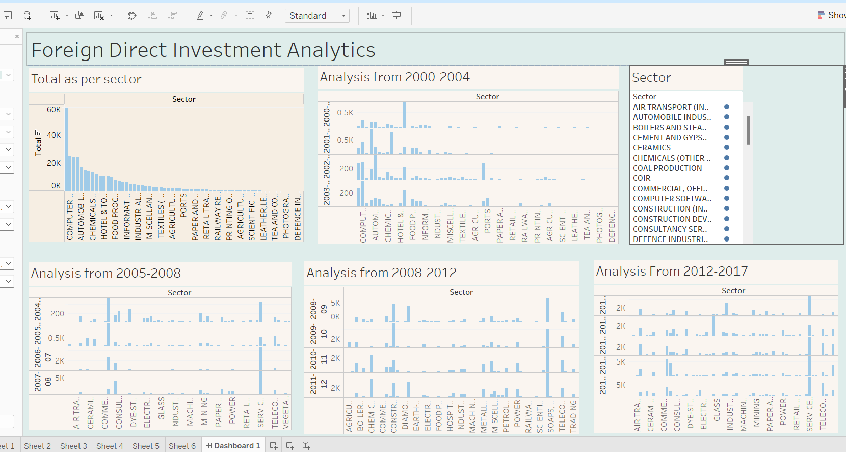

Slide 5
In this dashboard I analyse data firstly on the basis of total investment of whole years from 2000-2017 on the basis of all the sectors , from which I found that that
highest investment was in Service sector that is of 59,476 and
lowest investment was in Defence industries that is of 5

Slide 6
Then analyse the data on the basis of year from 2000 to 2017
From which I found that highest investment in
2000 was in Miscellaneous industries and
highest investment in 2017 was in service sector .

Slide 7


